Slide 1
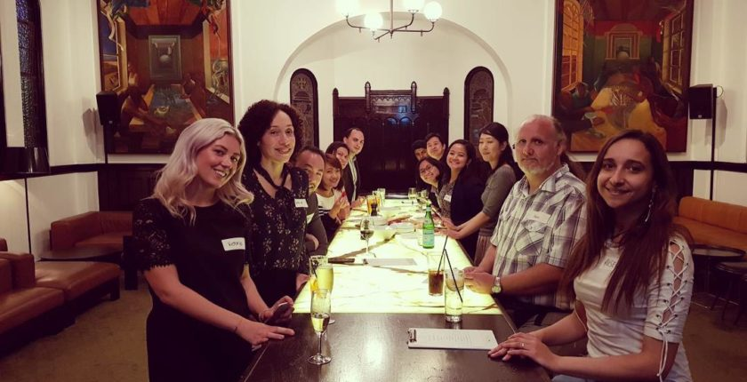
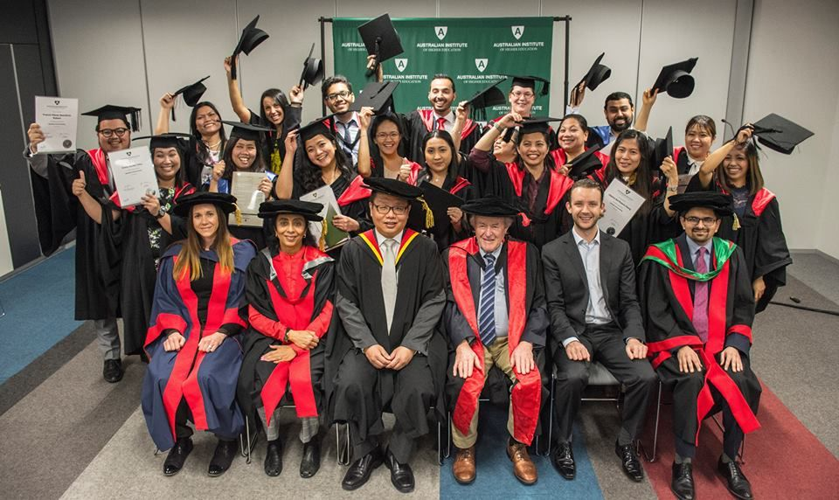
GRADUATION DAY CEREMONY
ABOUT THE EVENT
Australian Institute of Higher Education (AIH) has always valued its students the most and find different ways to express how much they are important to us. Through this live broadcast of graduation day ceremony, AIH welcomes the family of all students who are unable to attend the event, to watch their loved ones on convocation day and being honoured with bachelor’s degree. The event can be watched sitting anywhere in the world.
STEPS TO WATCH STREAM ONLINE
STEP 1: Register your email on our website
STEP 2: Verify your email
Step 3 : Log in using email
STEP $: Click on the link in event page on our website and watch live stream

